Slide 1


A PROJECT PRESENTATION ON ONLINE VOTING SYSTEM
Developed by:
Group No: 34
Pranav Kharche (1093)
Swapnil Chougule (1040)

Slide 2
Manual voting system has been deployed for many years in our country. However in many parts of our country people cannot attend the voting because of several reasons. In order to solve these problems there is a need of online voting system in addition to manual voting system. The long-term goal of this project is to greatly reduce the cost and complexity of running elections and increase the accuracy of results by removing the direct involvement of humans in gathering and counting of votes. The voters will be able to give their votes at any field areas by using the system if they prefer online voting. In this system, the voter votes using Java application which can be downloaded over internet The main objective of the proposed solution is to be automated the voting process and activities related to voting process through Internet.
ONLINE VOTING SYSTEM

Slide 3
1. REGISTRATION
That system will be used only by the people who have been registered to the system. Main actor of the registration operator is the voters & candidates
For security purpose, System can generate user id.

Slide 4
2. LOGIN AS A VOTER
Home
View Parties
View Candidates
Vote
Logout

Slide 5
3. LOGIN AS A CANDIDATE
Home
View Votes
Logout

Slide 6
4. LOGIN AS A POLITICALPARTY
Home
View Candidates
Activate Candidate Account
Logout

Slide 7
5. ADMIN
Home
View Voters
View Candidates
View Political Party
View Votes
Logout

Slide 8
6. ACTIVATE ACCOUNT
Admin will activate Voter and PoliticalParty account.
Political Party will activate Candidate account.

Slide 9
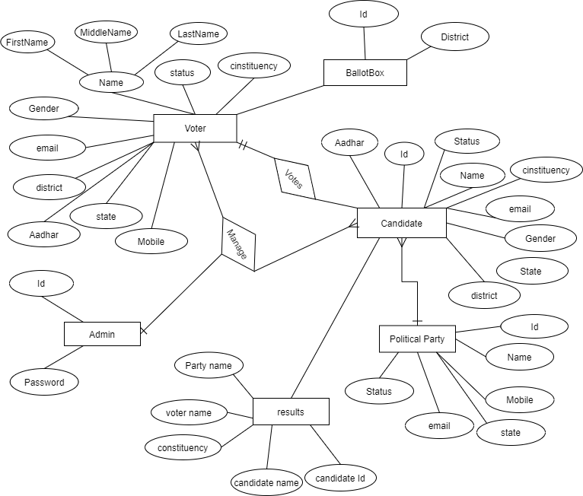
ER Diagram

Slide 10
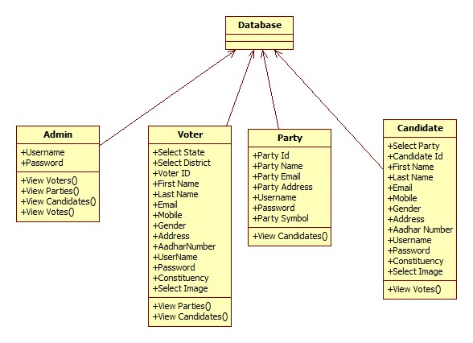
CLASS DIAGRAM

Slide 11
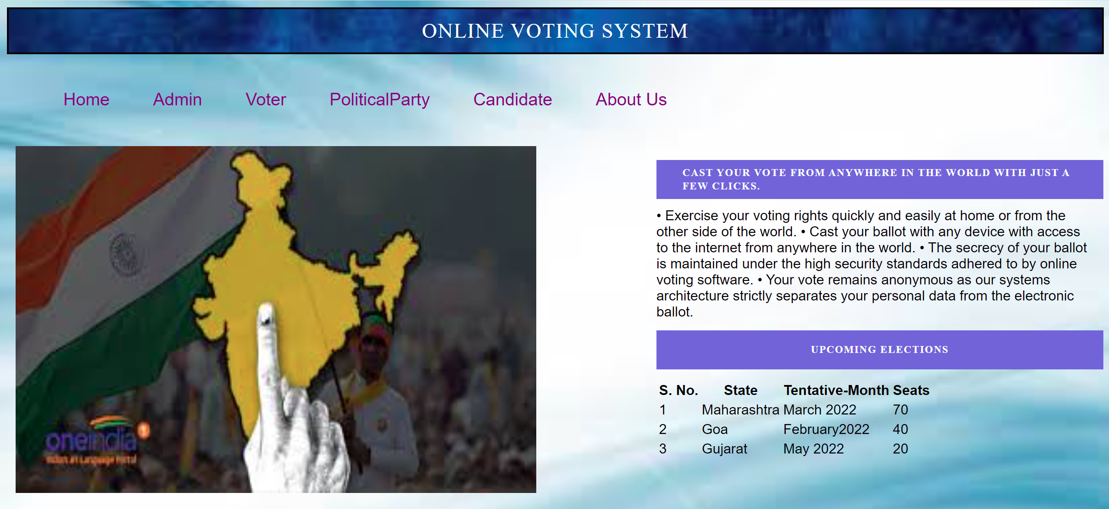

Slide 12
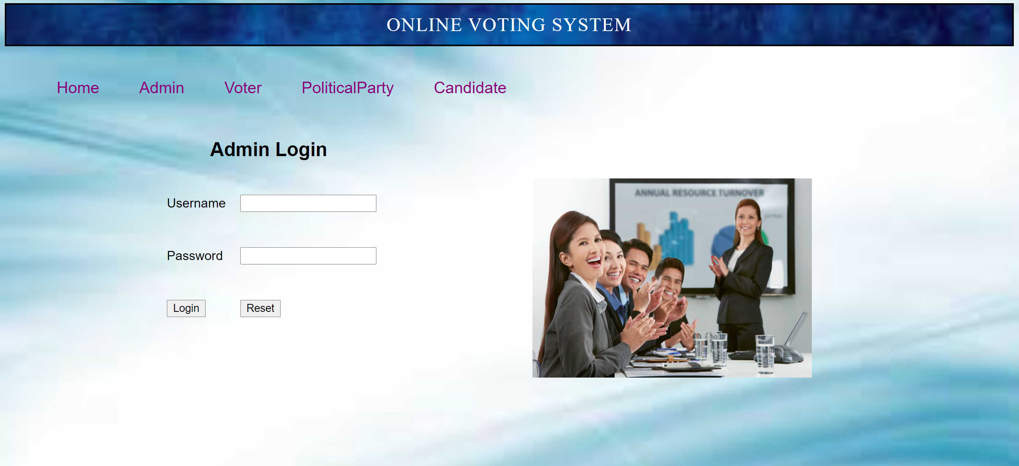

Slide 13
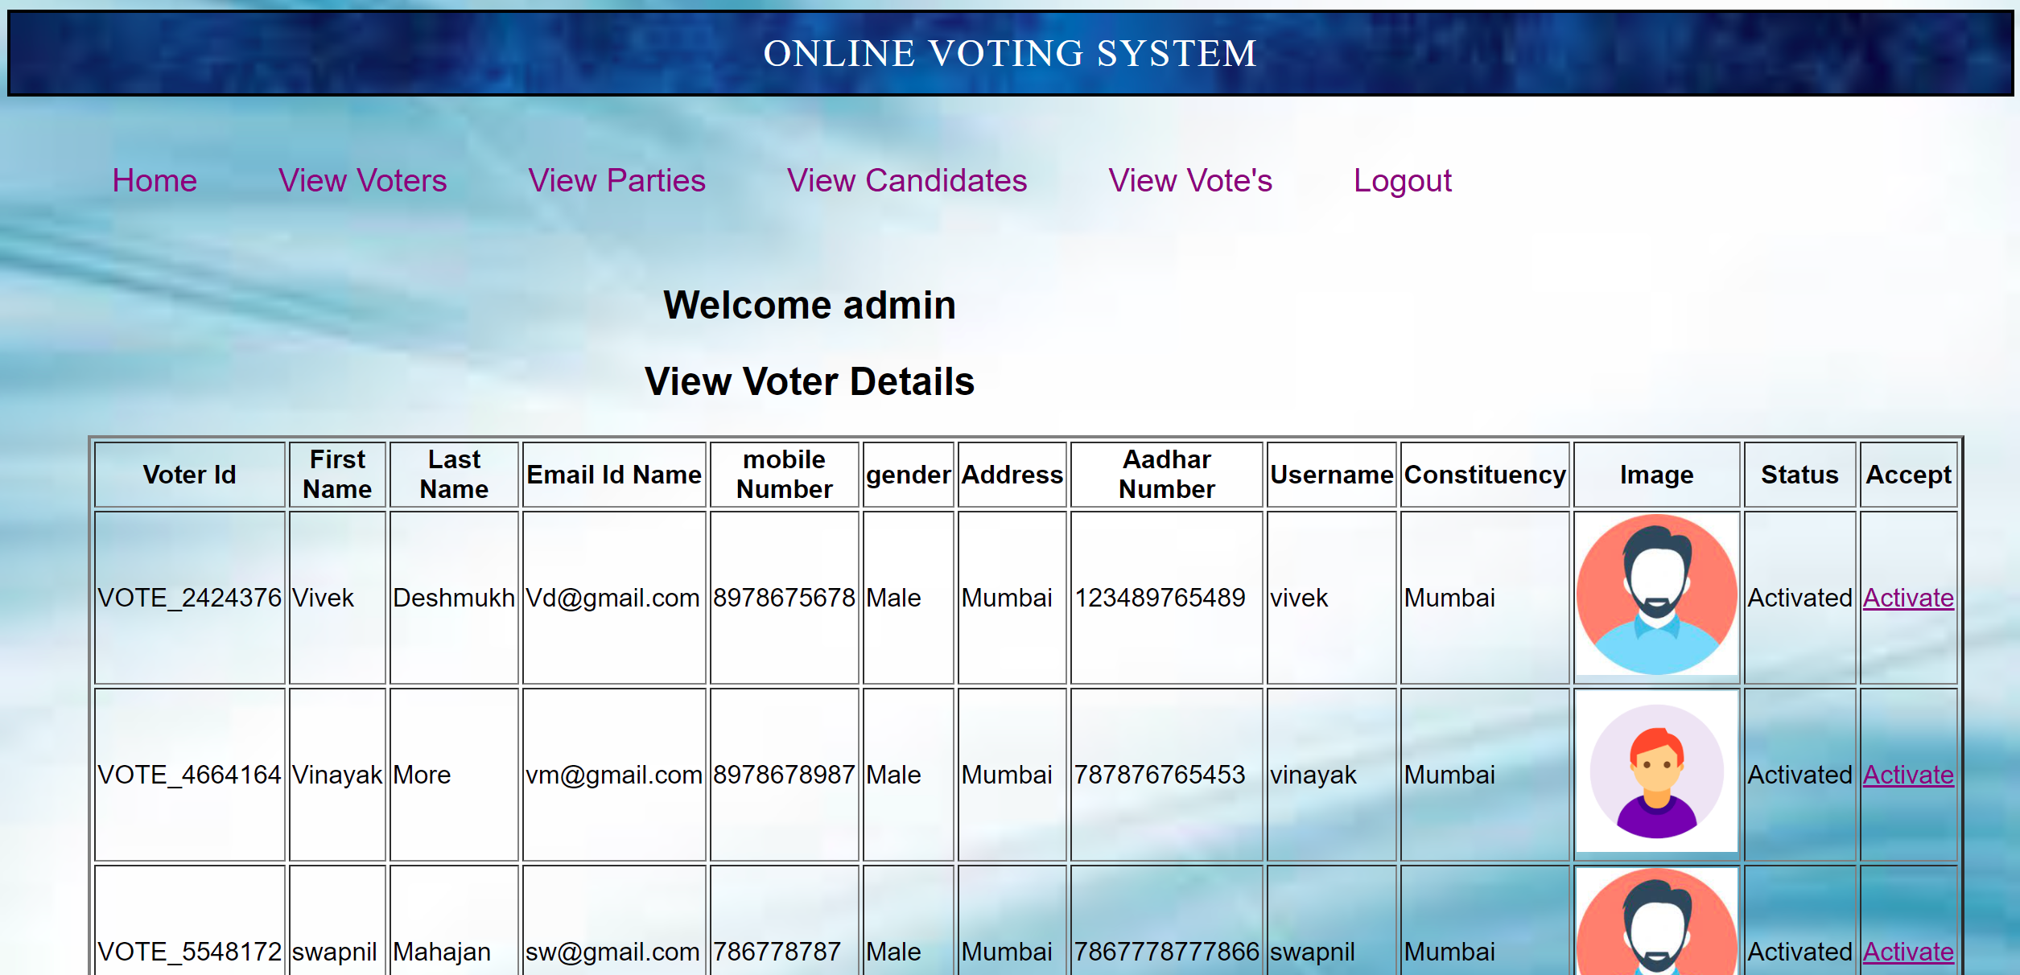

Slide 14
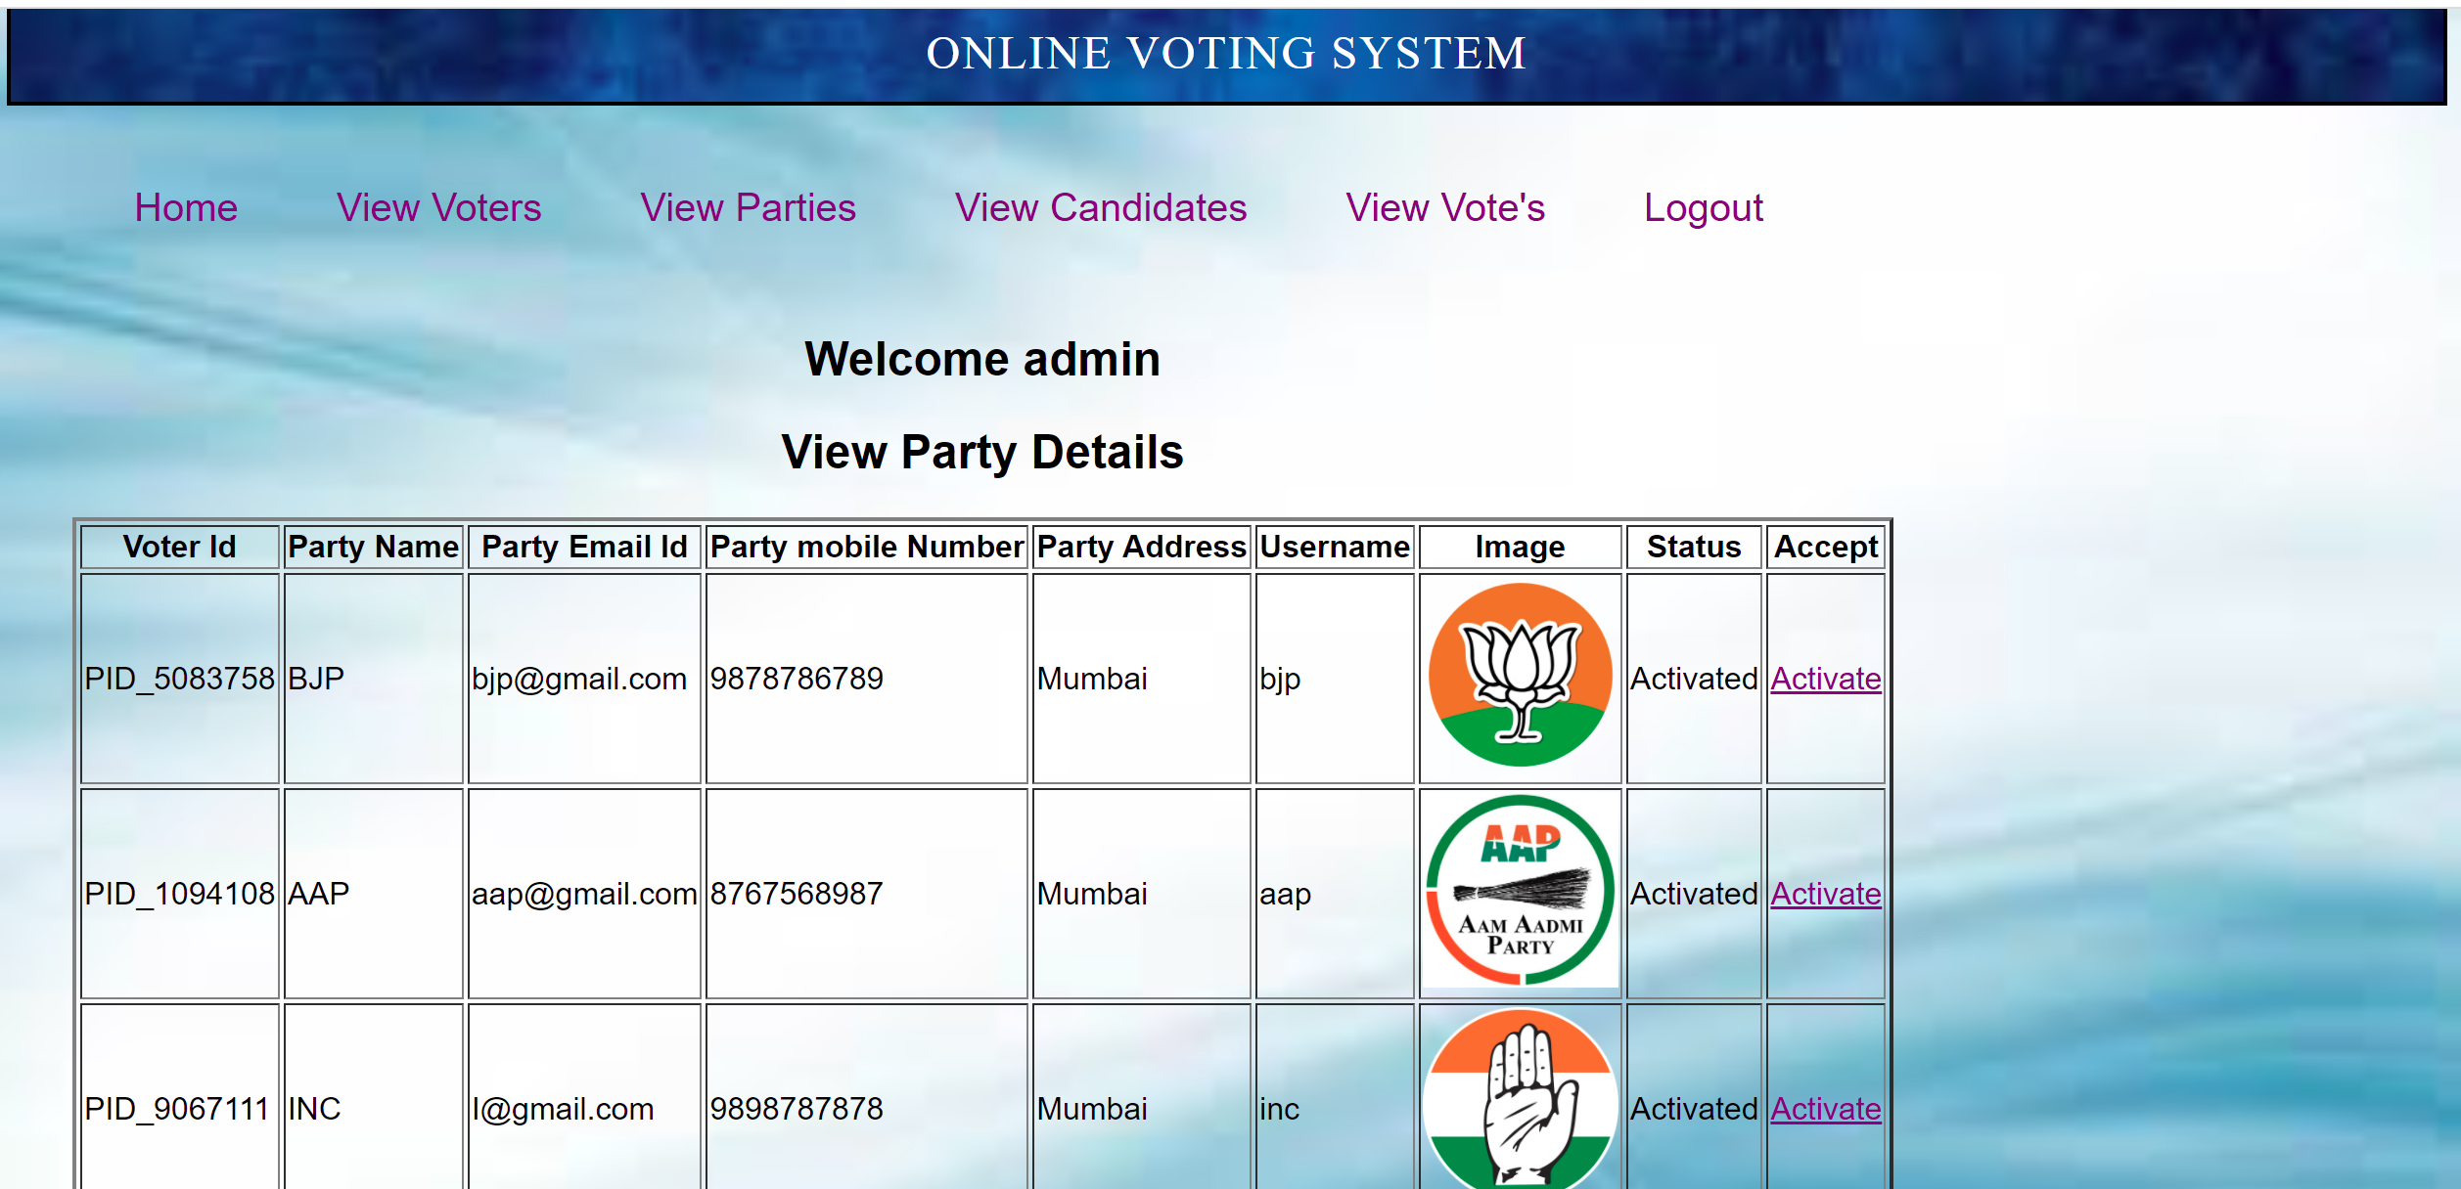

Slide 15
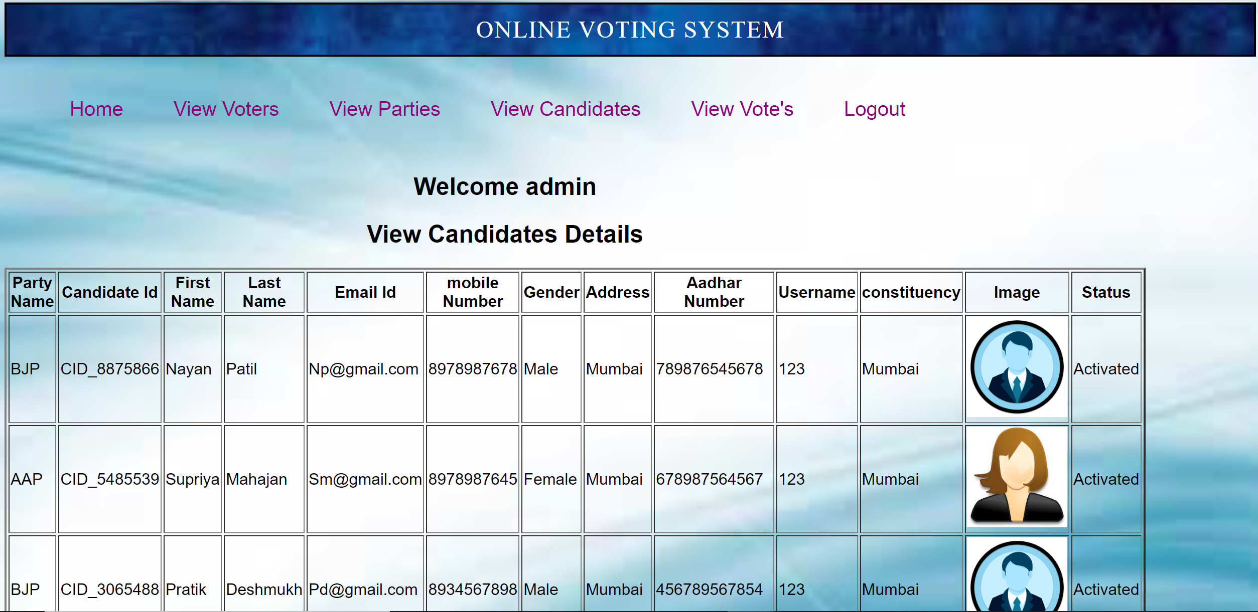

Slide 16
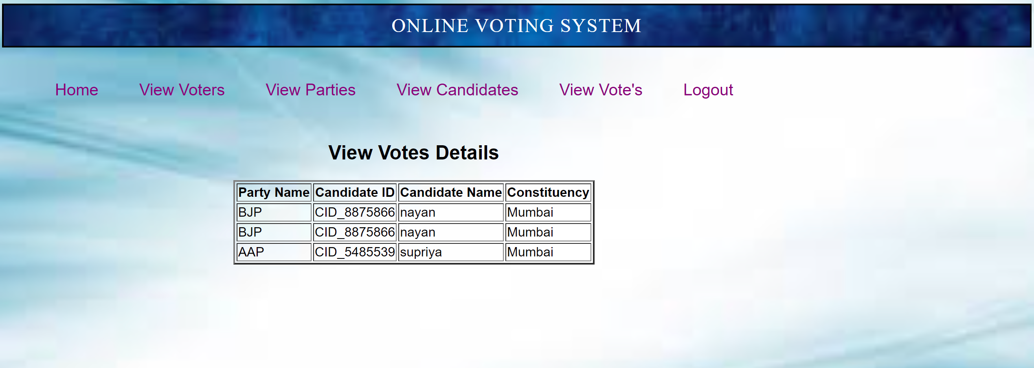

Slide 17
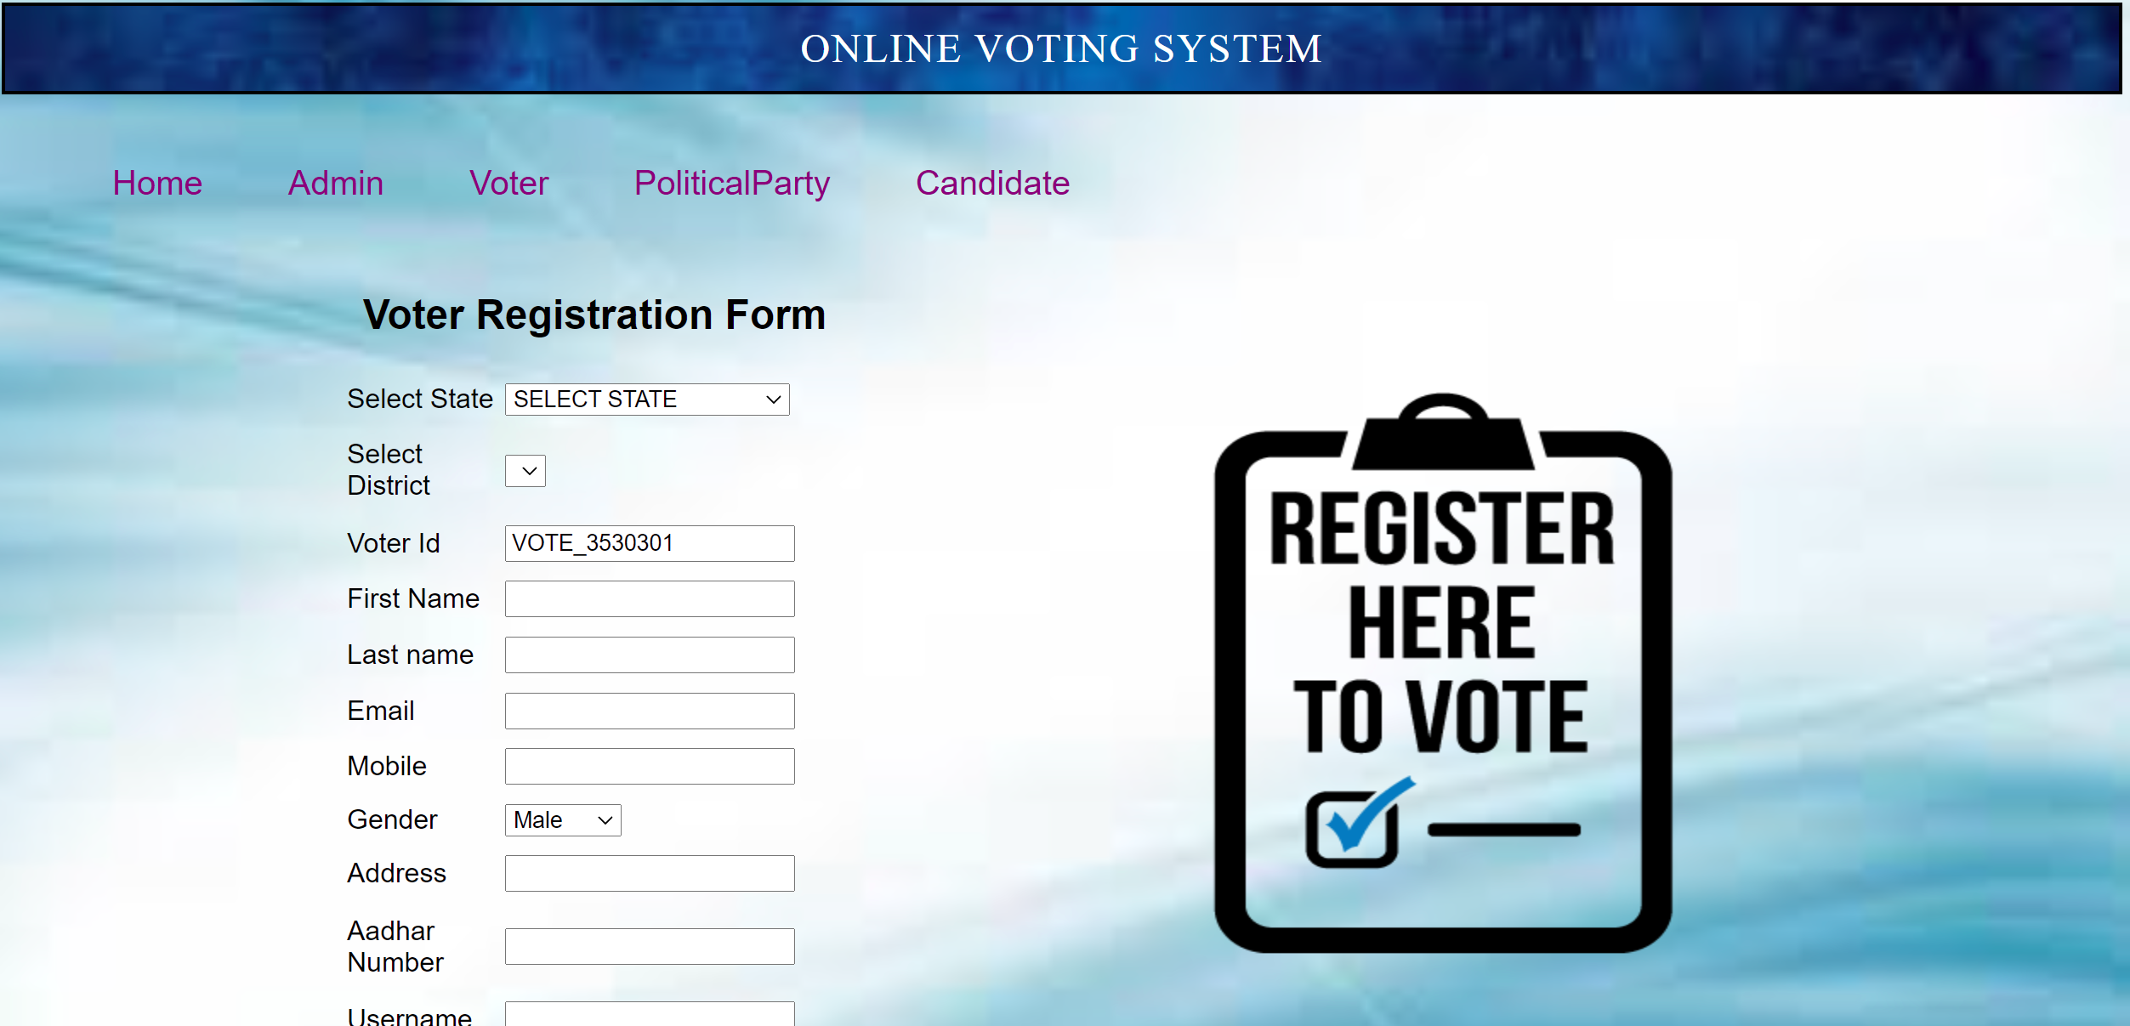

Slide 18
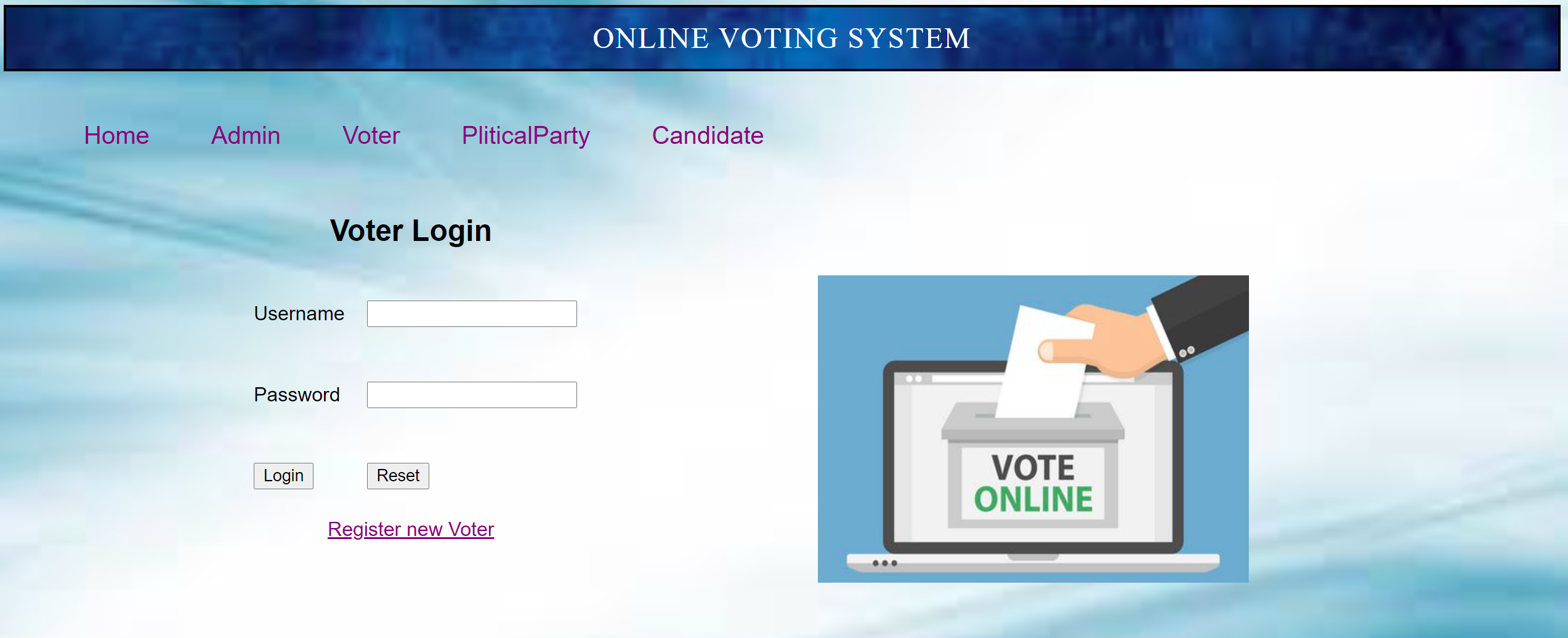

Slide 19
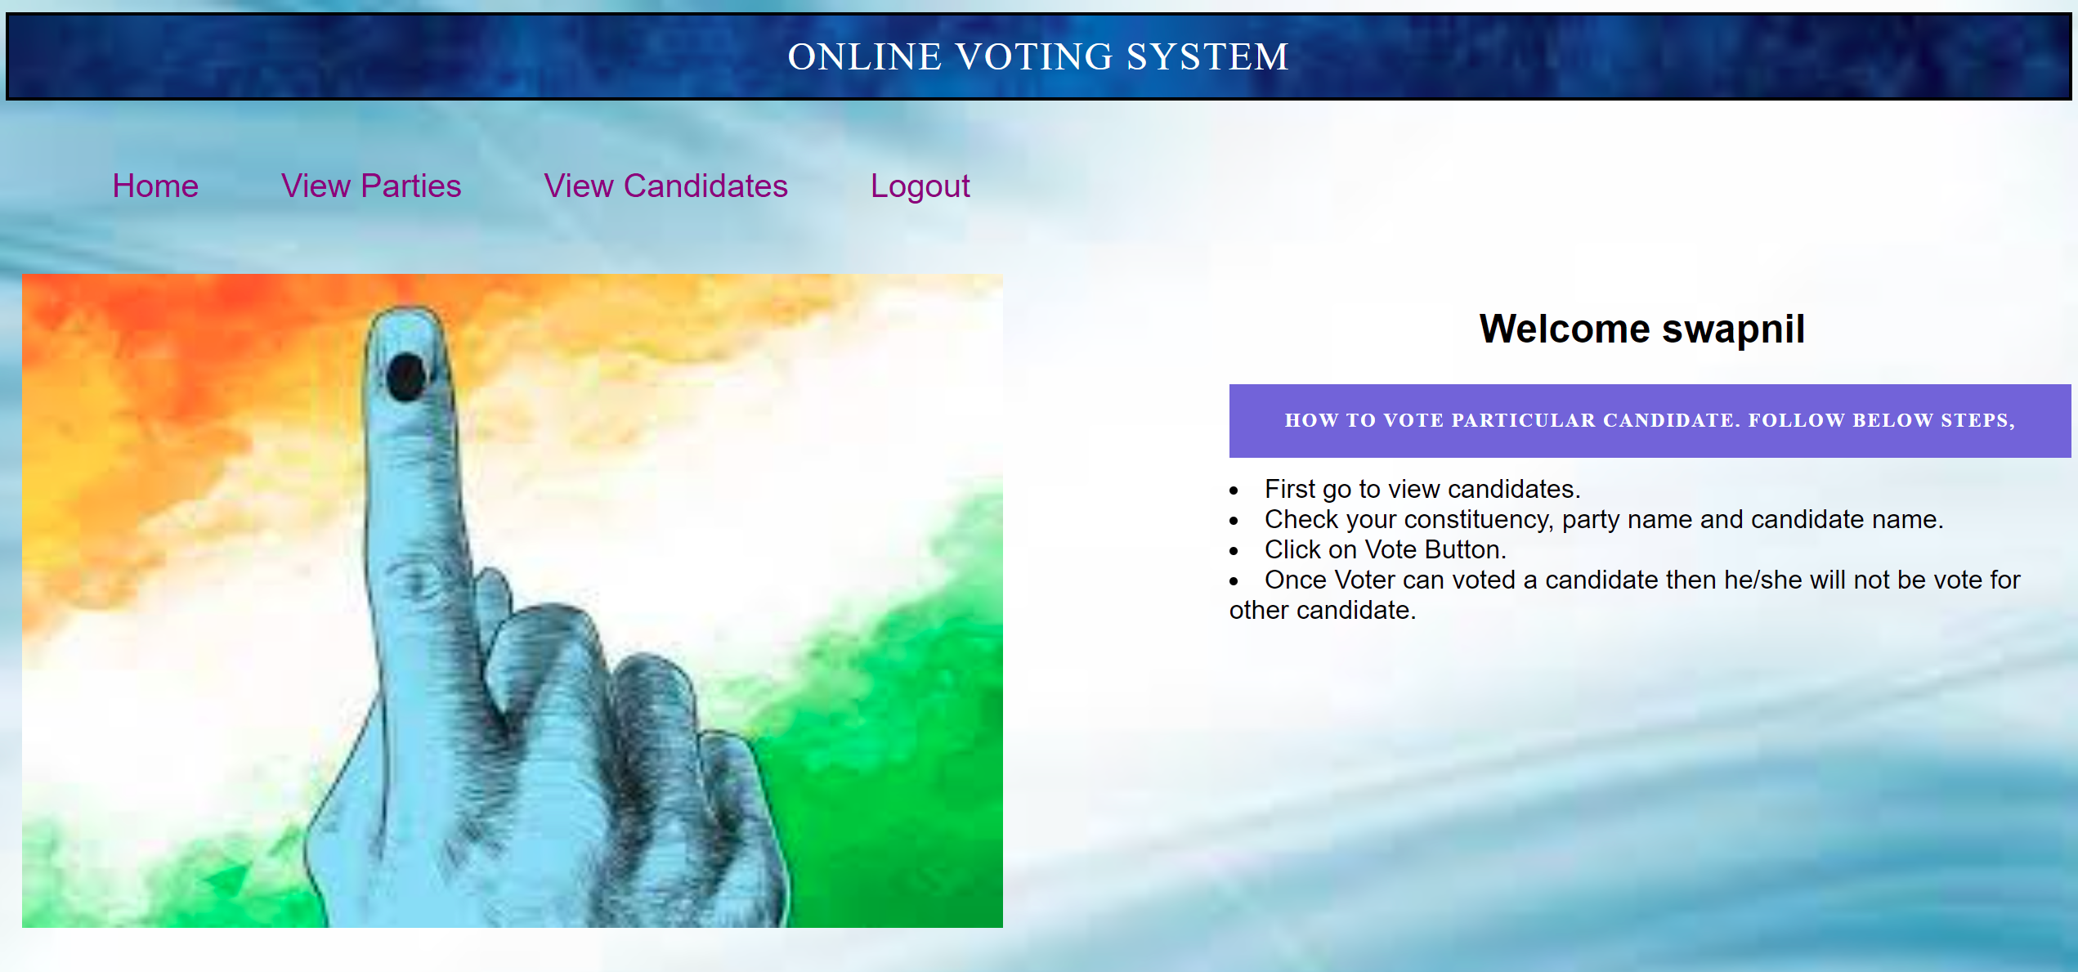

Slide 20
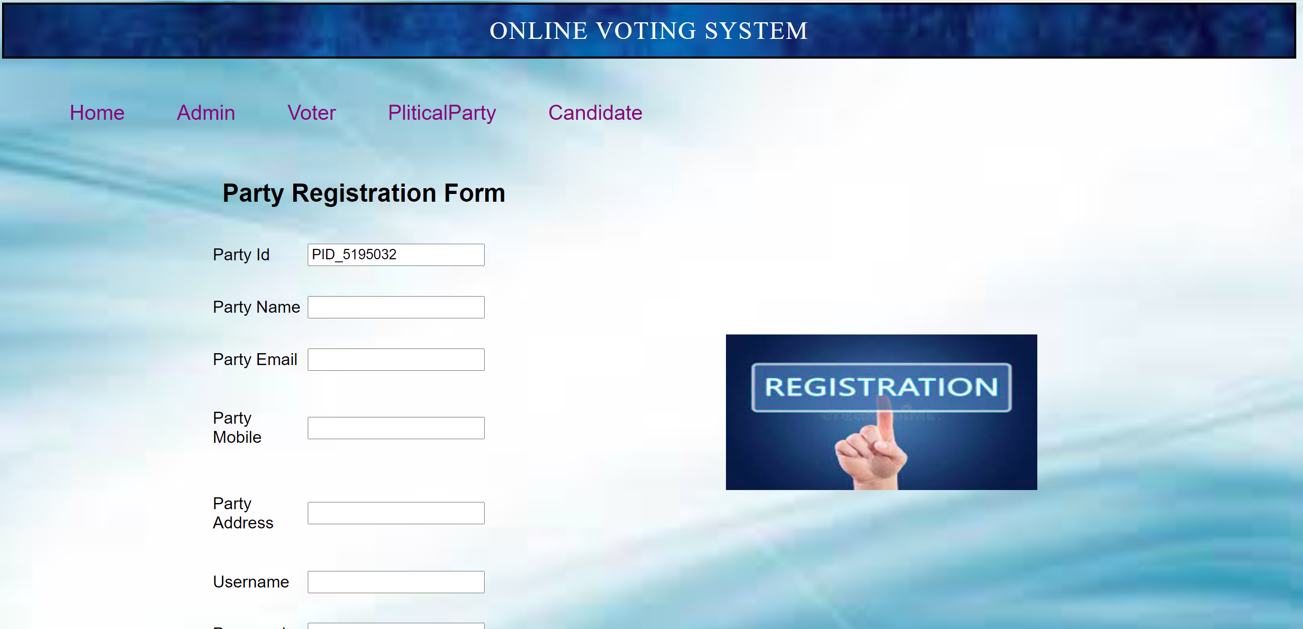

Slide 21
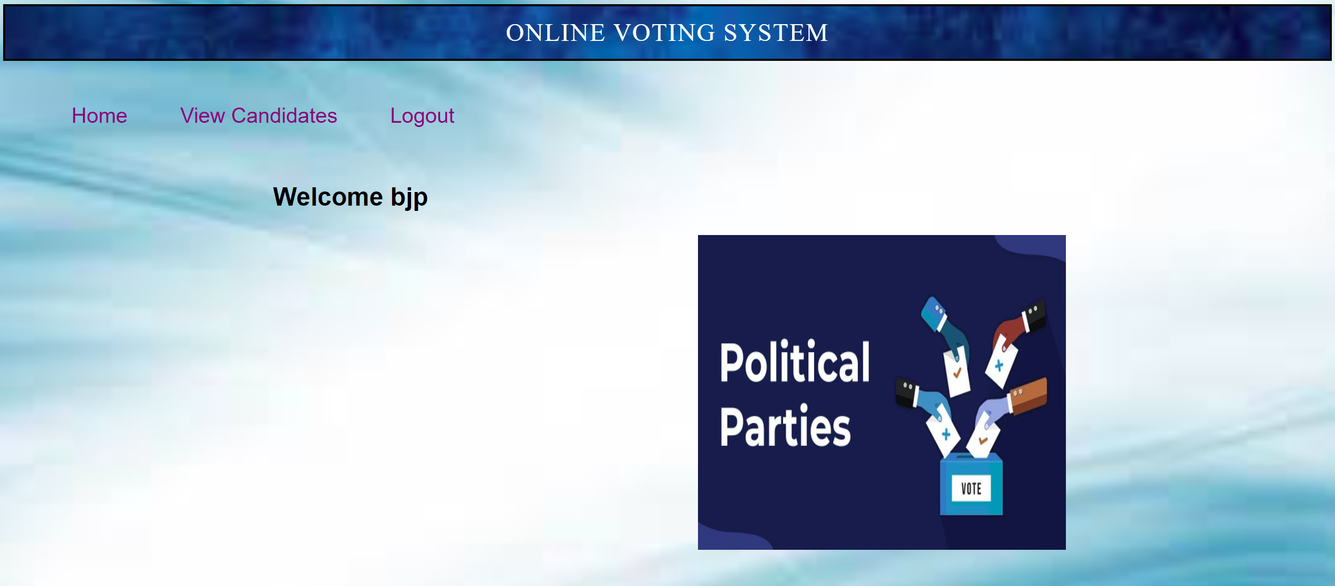

Slide 22
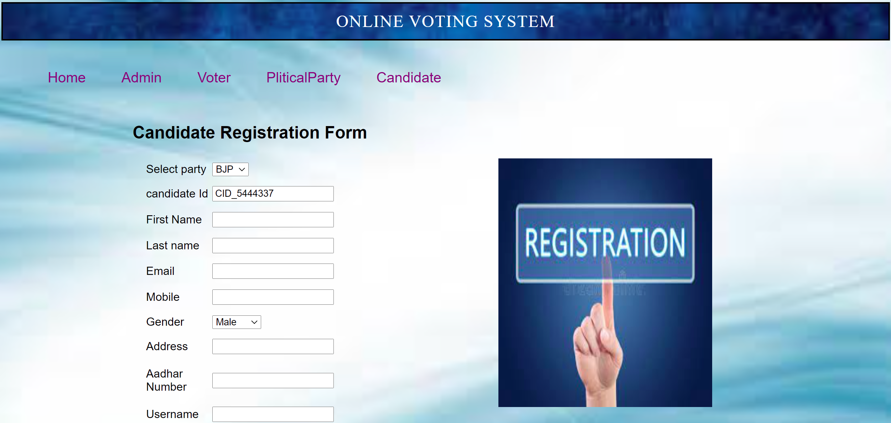

Slide 23
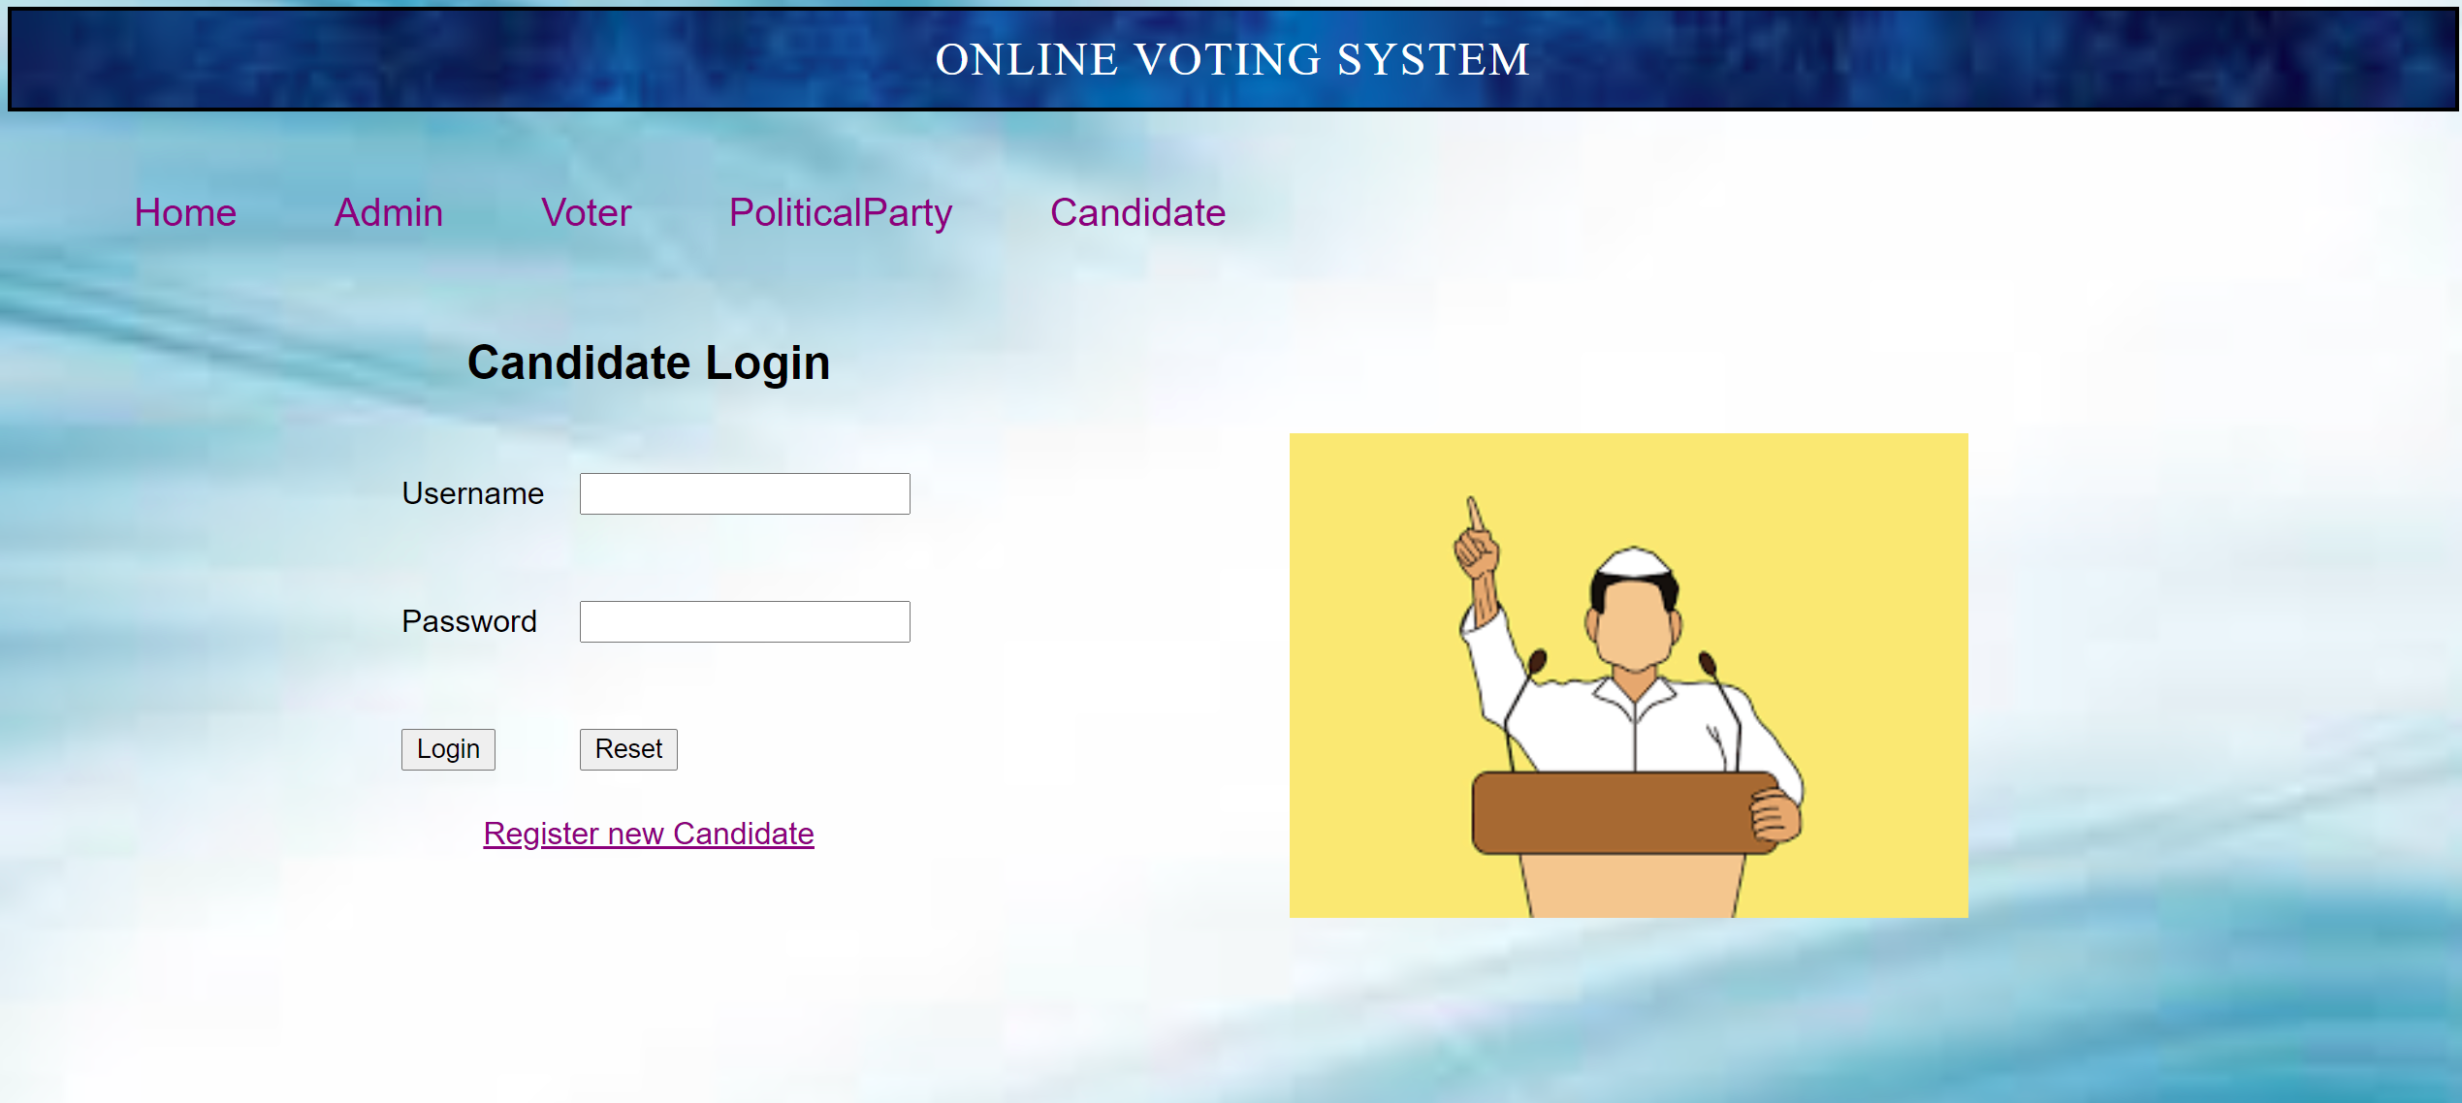

Slide 24
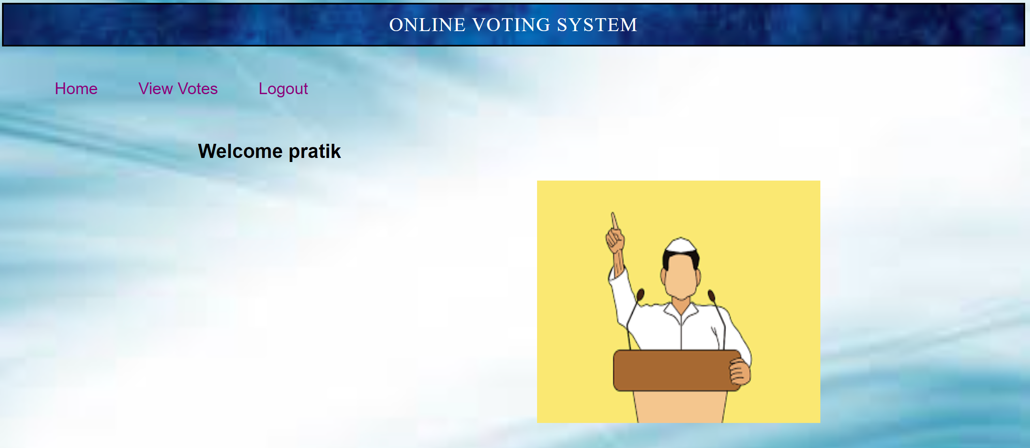

Slide 25
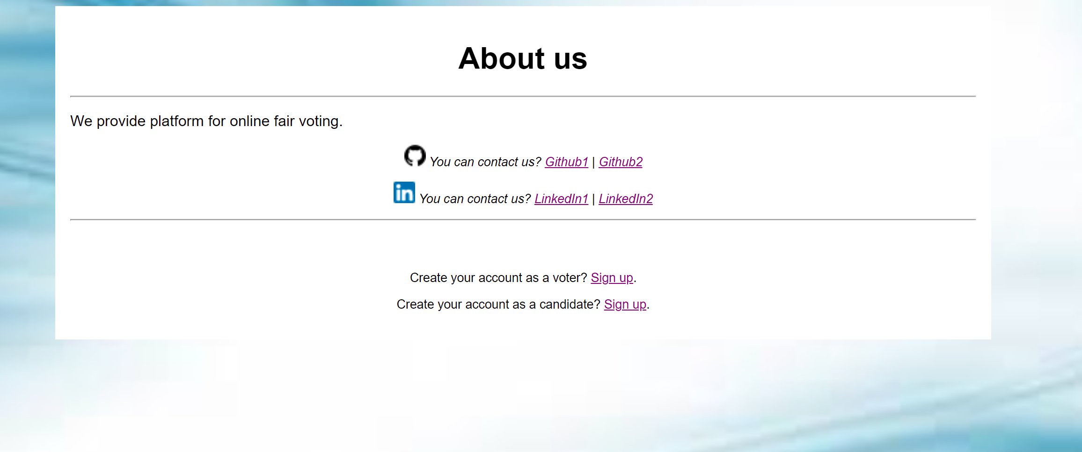

Slide 26


